Slide 1


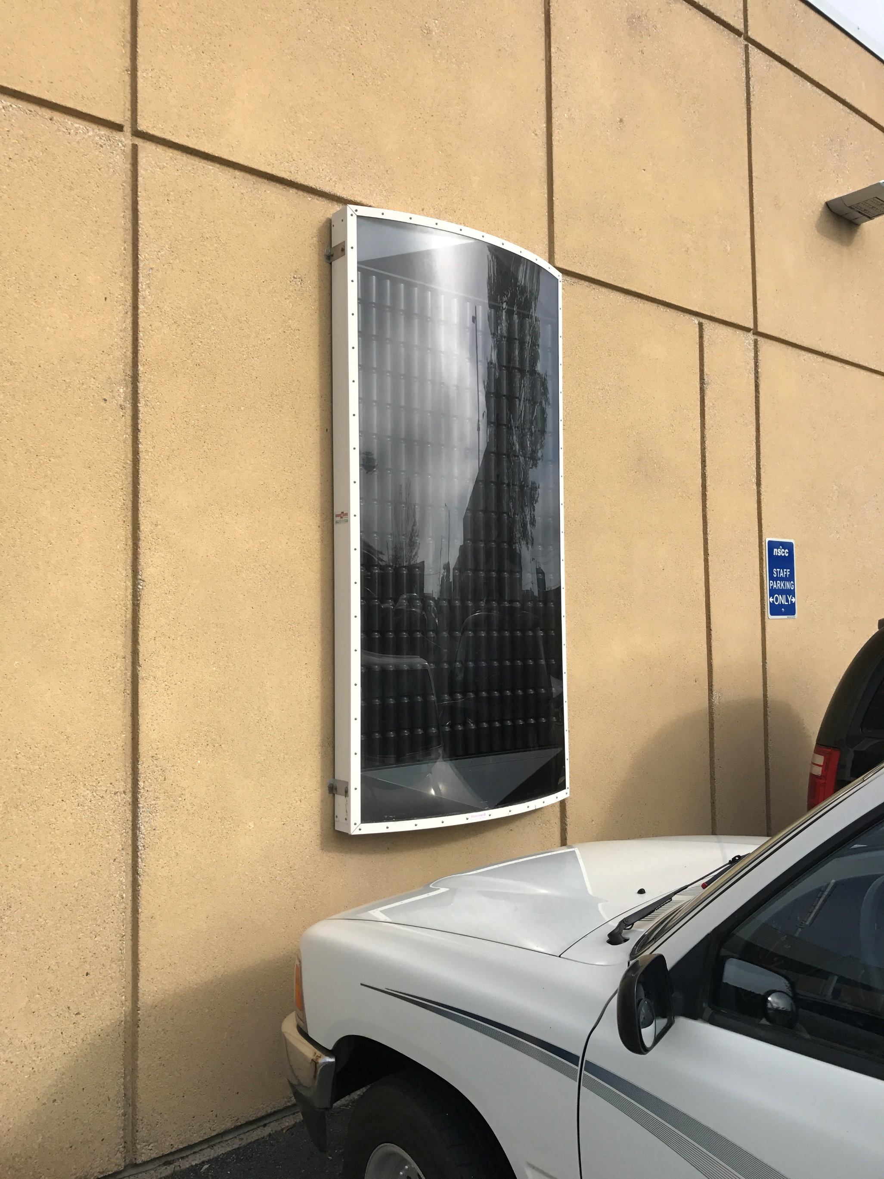
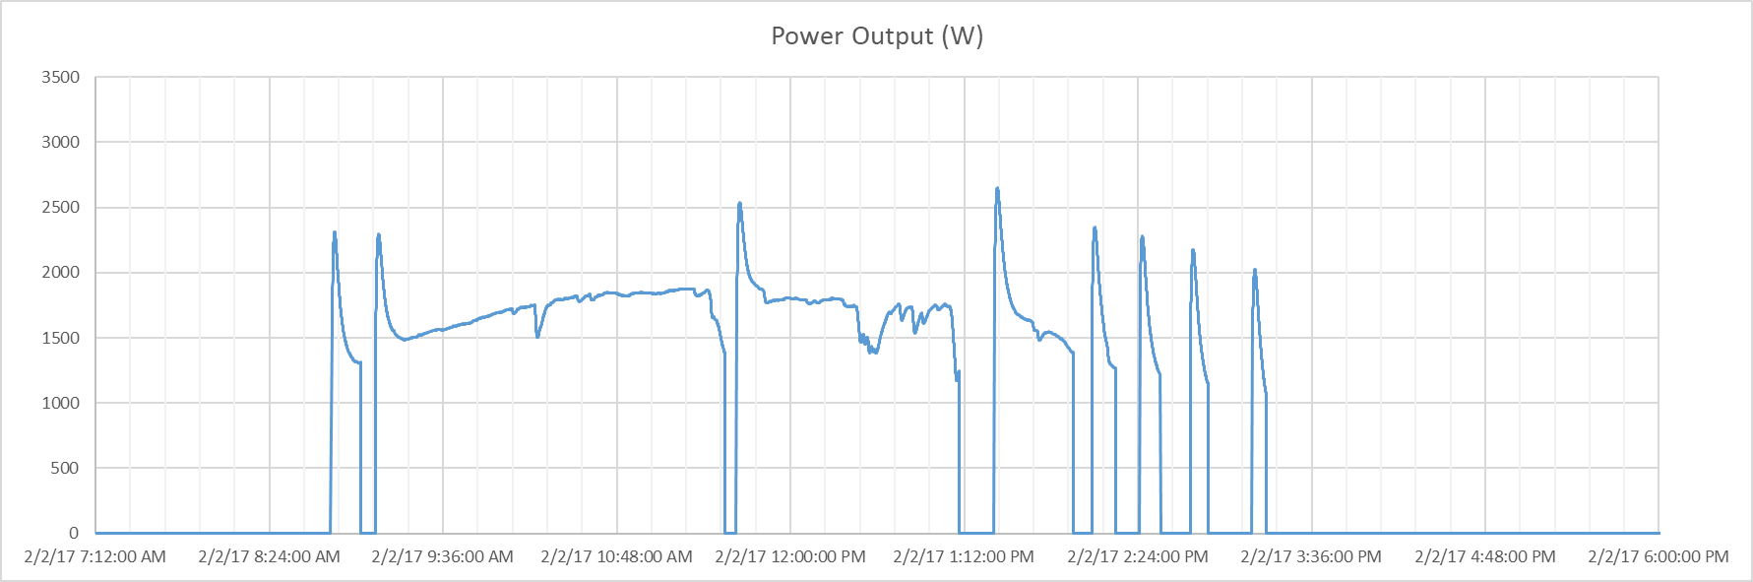
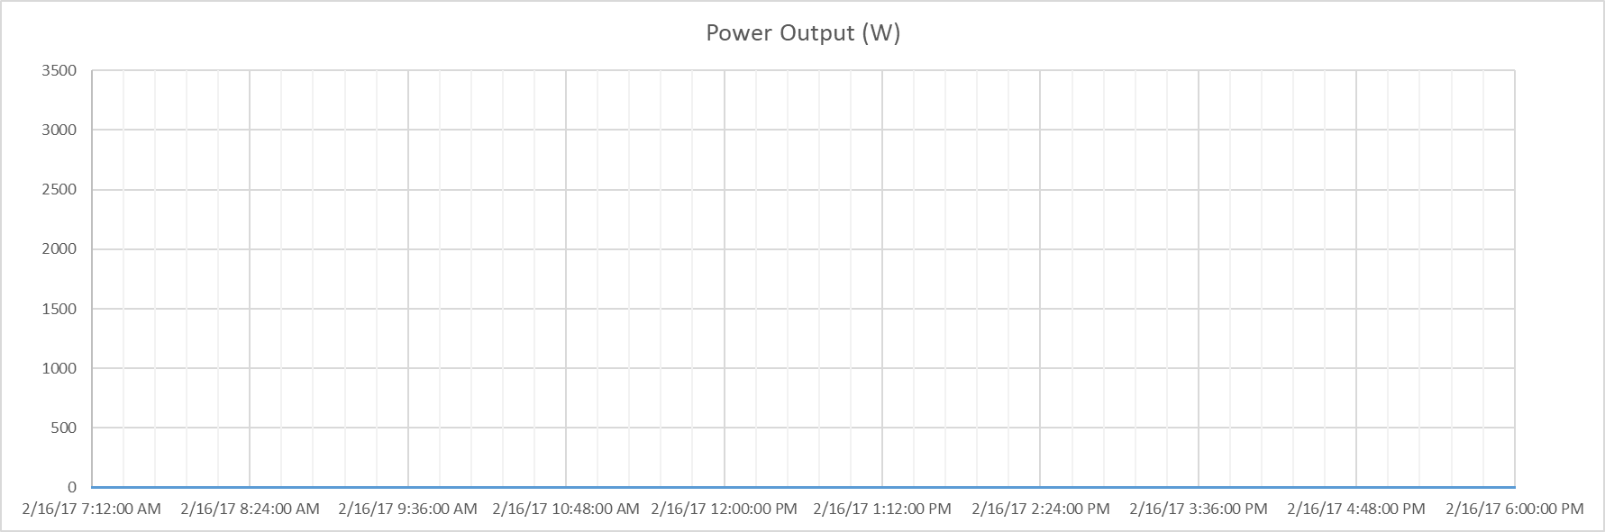

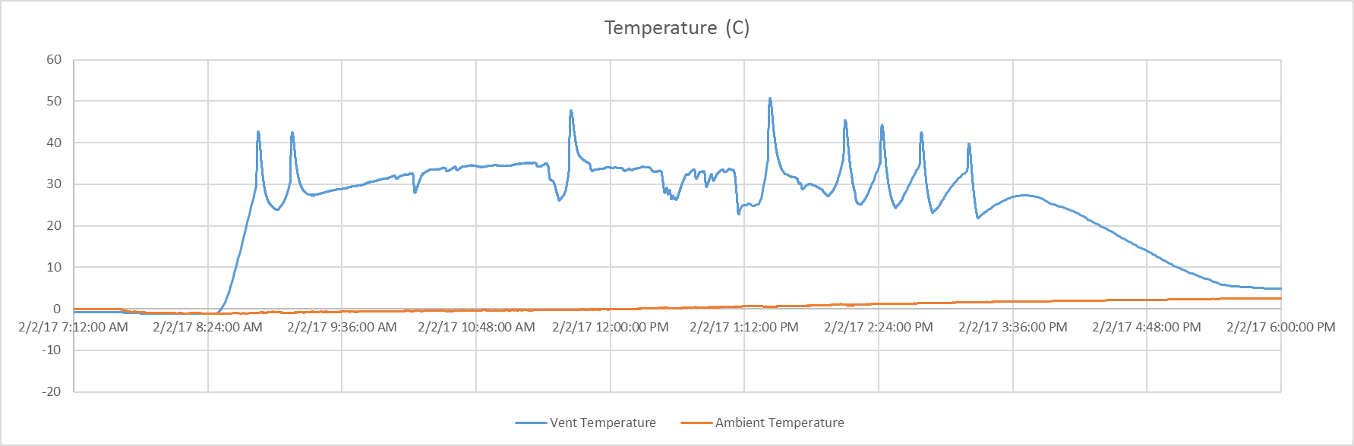
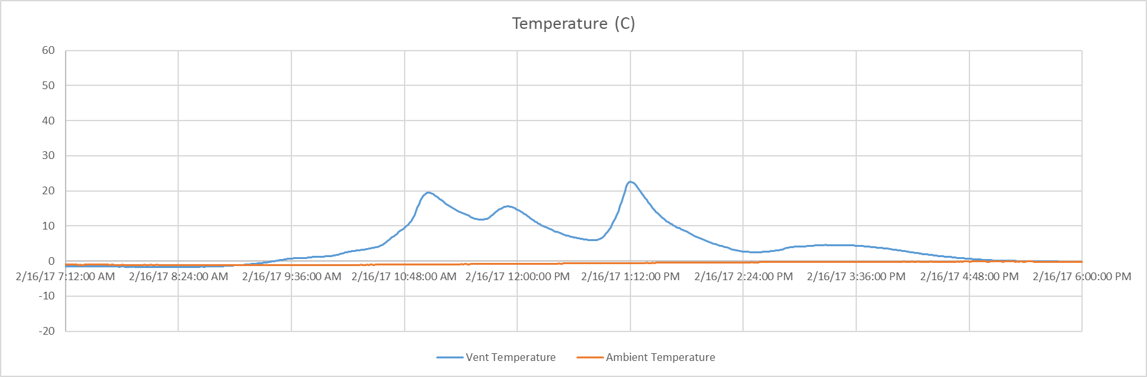
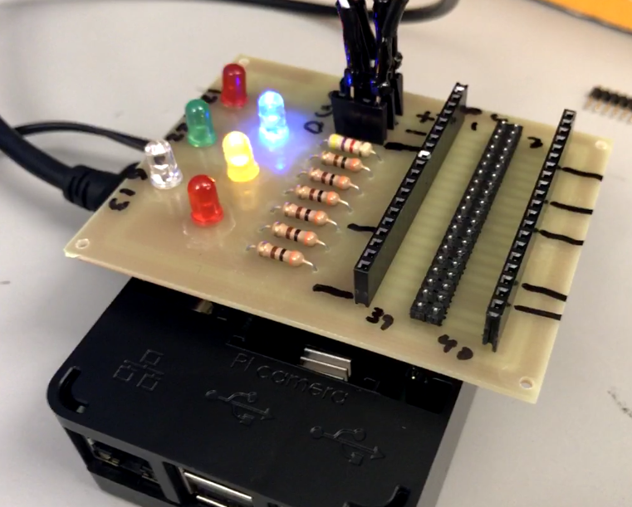
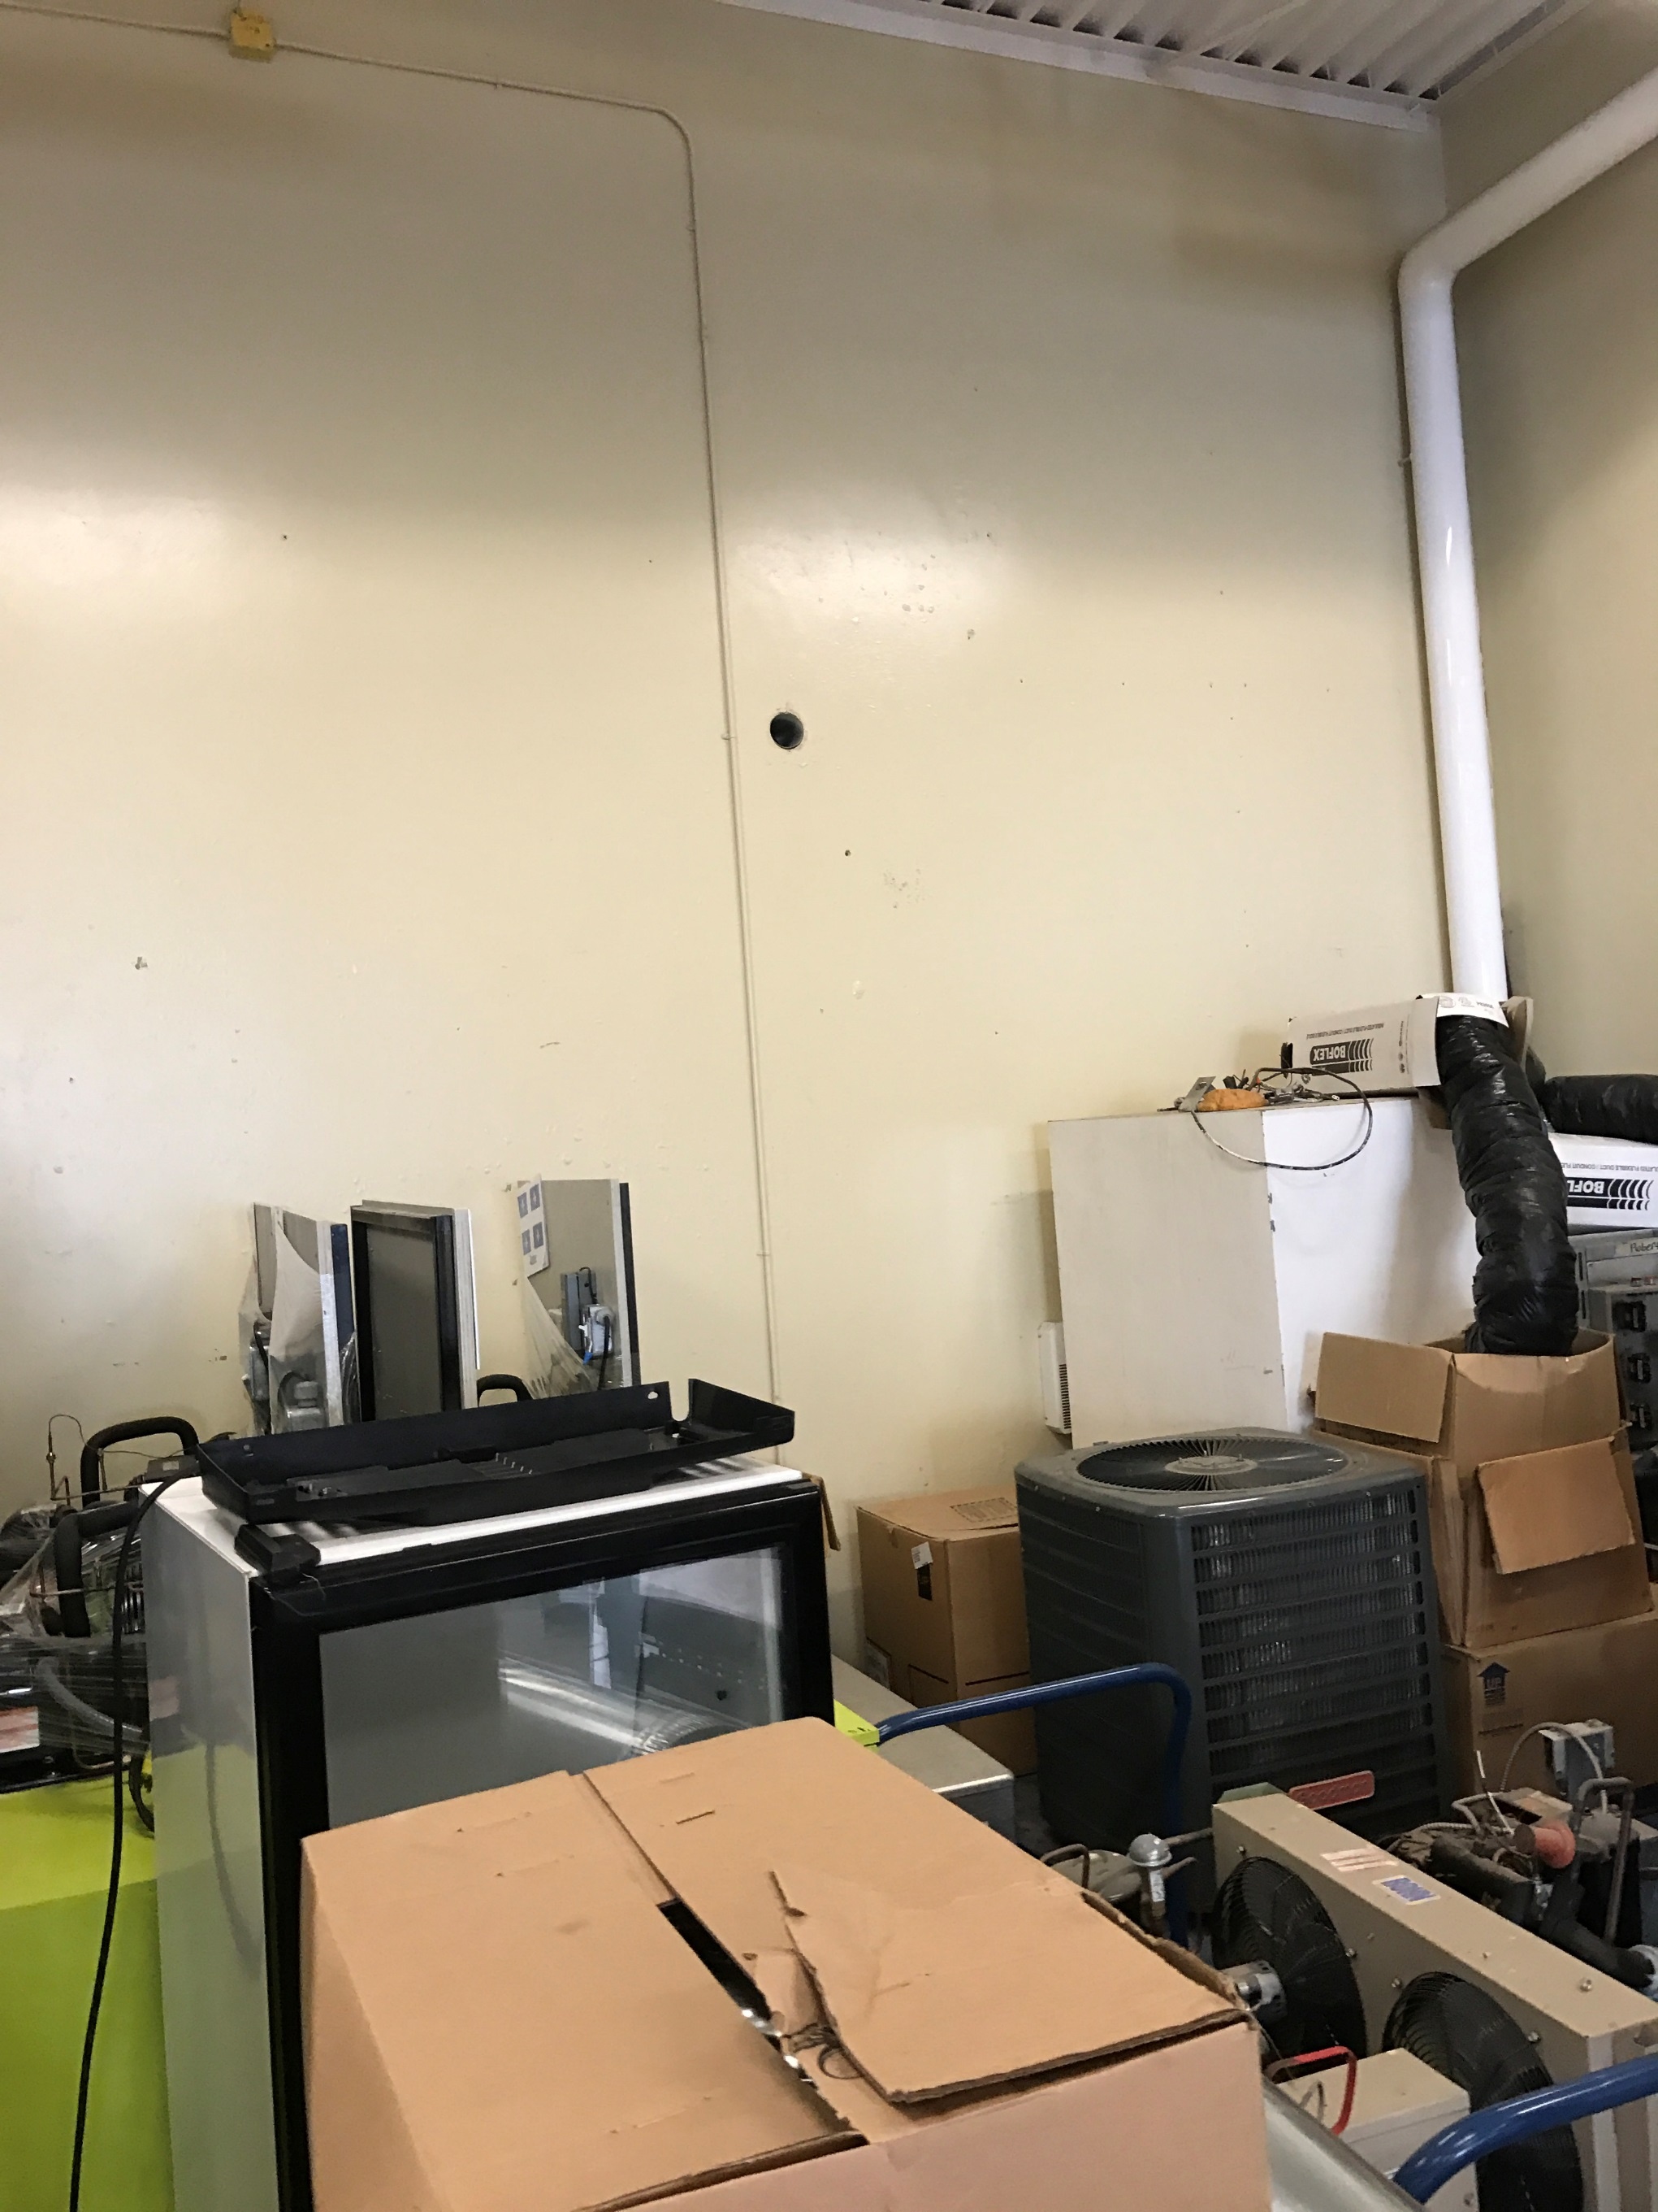
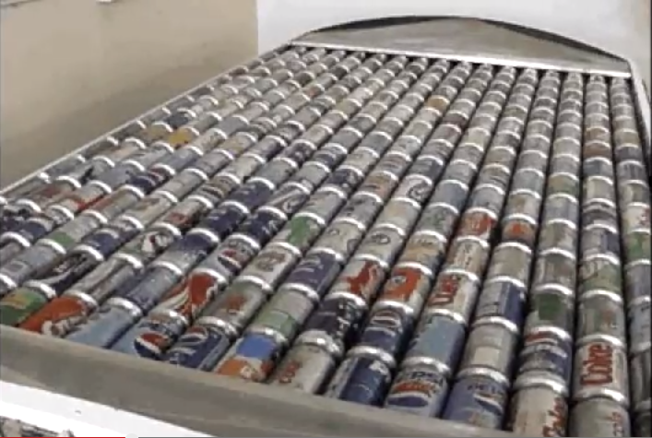
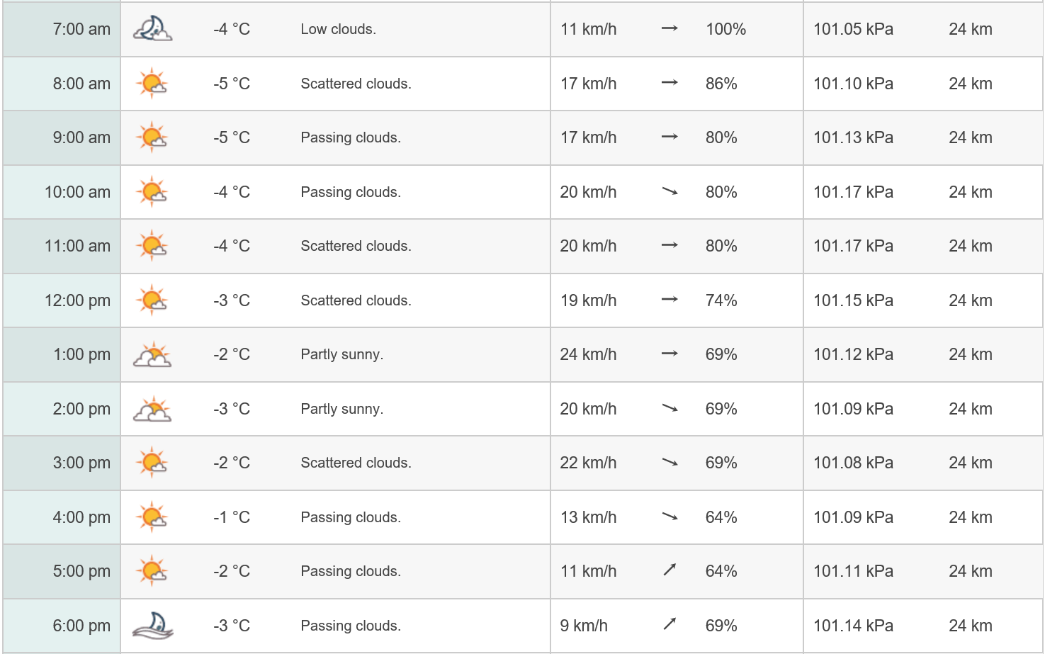
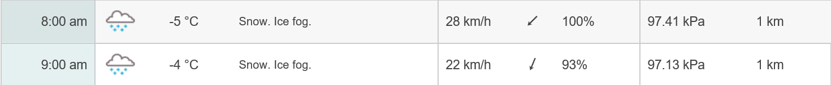
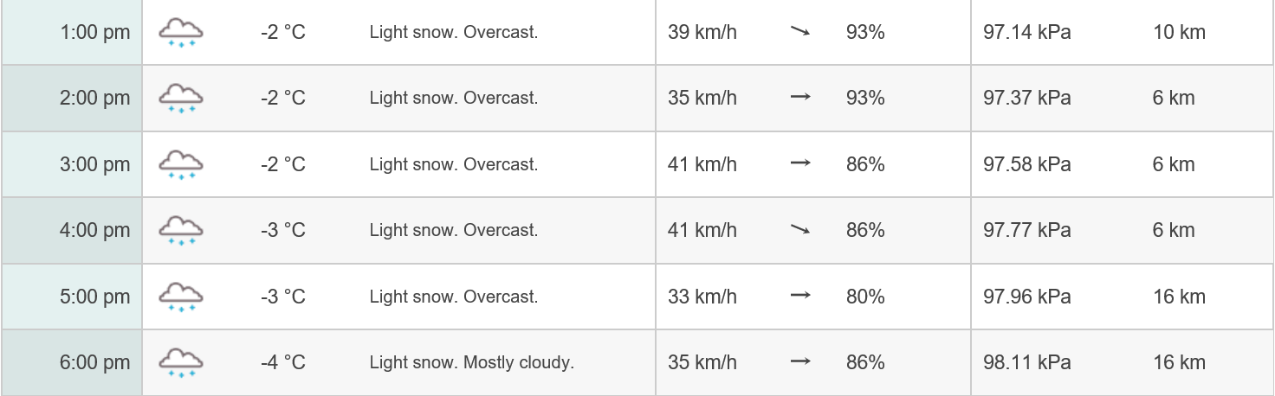
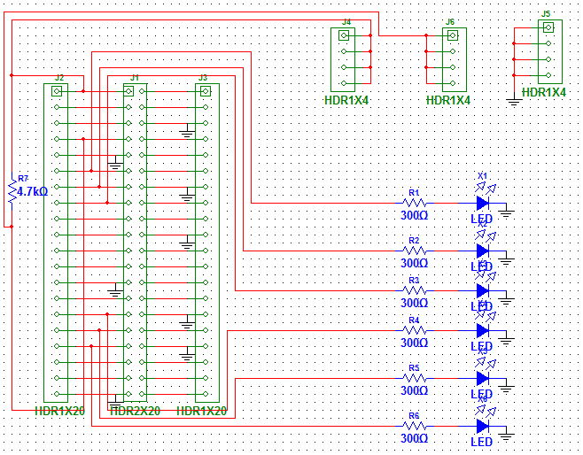
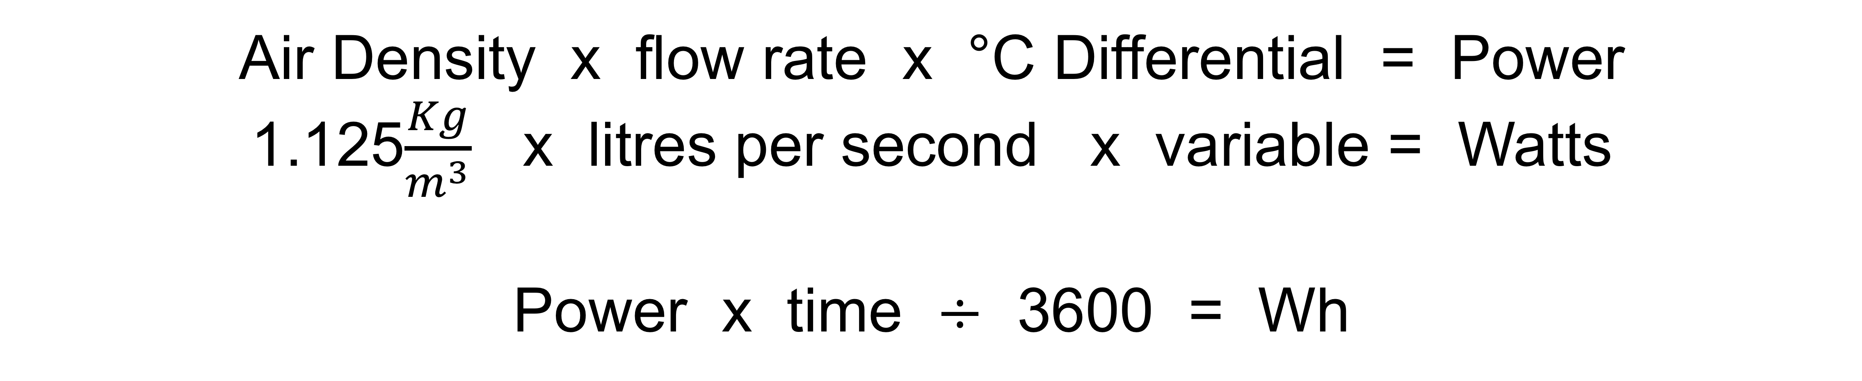
CANSOLAIR EFFICIENCY MONITORING SYSTEM
Solar Heater
Monitoring System
By: Dylan Stone
Efficiency Monitoring
Power Calculation
Data Saving and Easy USB transfers
LED Indicators
Feb 2nd, 2017
Feb 16th, 2017
Total kWh per day (February)
1 | 0
2 | 4.885
3 | 4.623
4 | 2.615
5 | 0.385
6 | 1.65
7 | 1.808
8 | 0
9 | 1.823
10 | 0.555
11 | 0.888
12 | 4.138
13 | 0
14 | 0.238
15 | 0
16 | 0
17 | 0.330
18 | 1.665
19 | 0
20 | 0.150
21 | 4.478
22 | 3.71
23 | 2.775
24 | 2.433
25 | 0.580
26 | 0.948
27 | 4.900
28 | 4.608
Total | 50.185
 | $7.56
Temperature Sensor:
Prototype:
4.885 kWh
0 kWh
Air Density x flow rate x °C Differential = Power
1.125$\frac{Kg}{m^{3}}$ x litres per second x variable = Watts
Power x time $÷$ 3600 = Wh
PCB Schematic
Weather by CustomWeather, © 2017

